Slide 1
Data Mining
HW3: News Recommendation Prediction
TA: Hank Chen
h7a4n1k.cs12@nycu.edu.tw

Slide 2

Task Description
Topic: News Recommendation Prediction
You are given several entries of user interaction history, you need to use these information to predict whether a user will click on a news or not.
Goal: Use any model or method to predict whether a user will click on a news.
Submit a report and source code to E3
Upload your prediction to Kaggle competition

Slide 3
Dataset
You are given 2 datasets (download via Kaggle), train and test, each with 3 files:
behaviors.tsv
entity_embedding.vec
news.tsv

Slide 4
Dataset (cont.)
behaviors.tsv
user_id: user id.
time: the time the user visited the website homepage.
clicked_news: space-separated list of user’s click history.
impressions: space-separated list (15 items), whether user clicked on the recommended news or not. (Format: {news_id}-{clicked}, clicked is 0 or 1.)

Slide 5
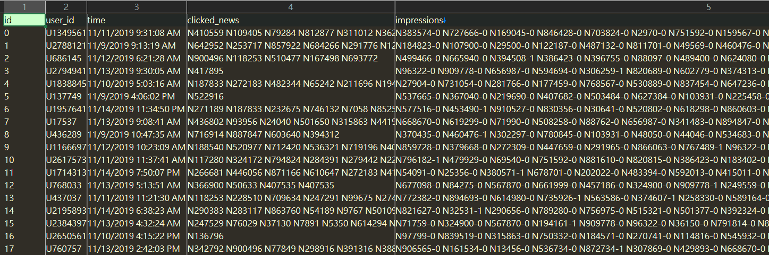
Dataset (cont.) - behaviors.tsv -train

Slide 6
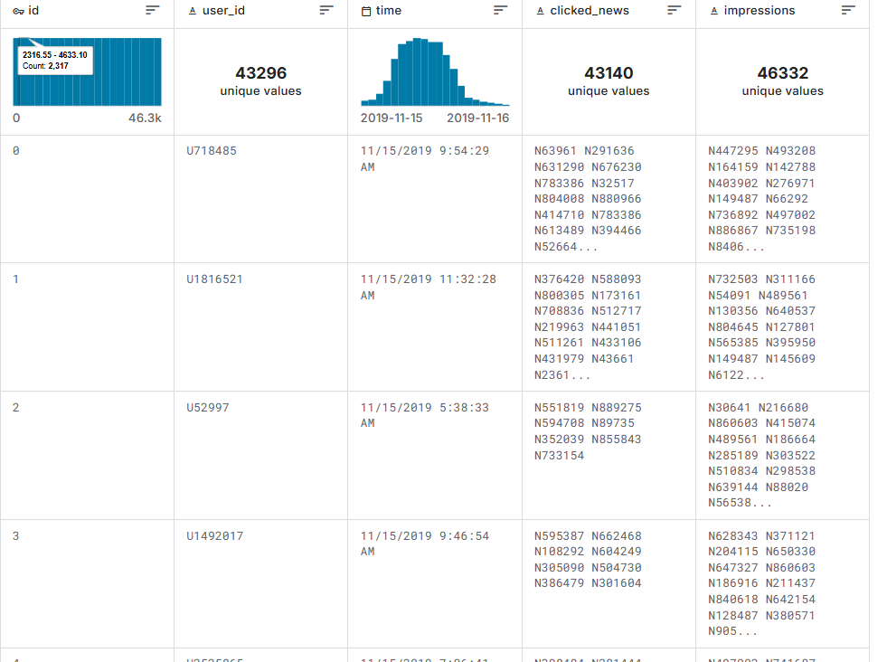
Dataset (cont.) - behaviors.tsv -test

Slide 7
Dataset (cont.)
news.tsv
news_id
category: news category.
subcategory: more fine-grained news category.
title: title of the news.
abstract: (possibly empty) abstract of the news.
URL

Slide 8
Dataset (cont.)
news.tsv (cont.)
title_entities: special entities in news title that is linked with Wikidata. (Format: json list, each item is a linked entity)
abstract_entities: special entities in news abstract.

Slide 9
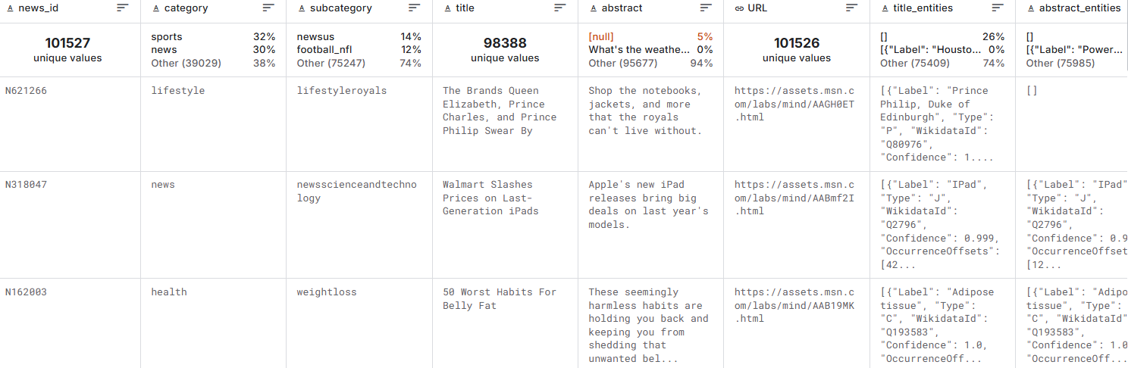
Dataset (cont.) - news.tsv -train

Slide 10
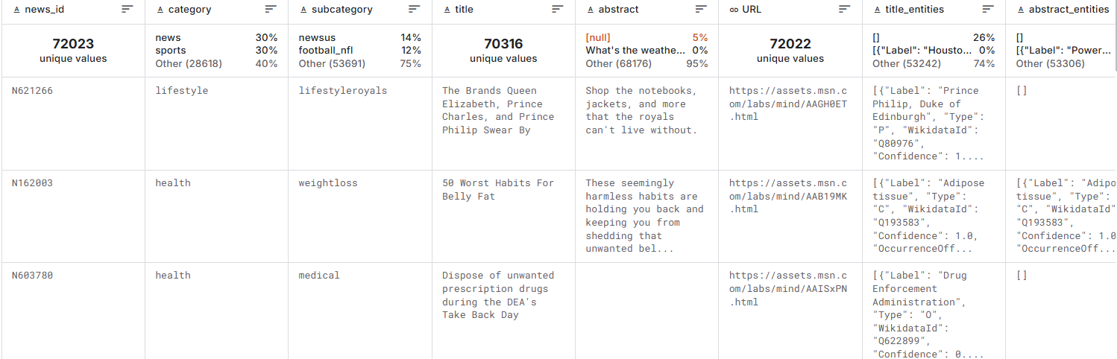
Dataset (cont.) - news.tsv -test

Slide 11
Dataset (cont.)
entity_embedding.vec
For convenience, we provide 100-D trained embeddings of special entities. (tab separated)
You can also use your preferred embeddings.

Slide 12
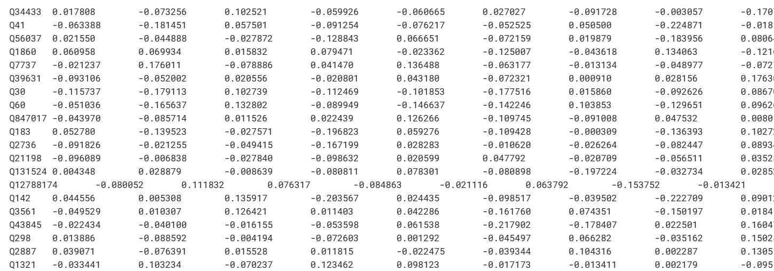
Dataset (cont.) - entity_embedding.vec - train

Slide 13
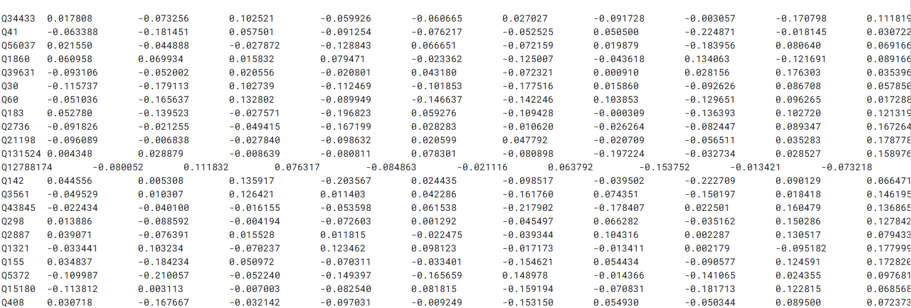
Dataset (cont.) - entity_embedding.vec - test

Slide 14
Kaggle
Competition Link
Create a team with your student ID, we use this information for grading.
If you failed to do so under any circumstances, there will be a penalty of 5 points to your score, so be sure to use the correct team name.

Slide 15
Kaggle (cont.)
Public leaderboard is calculated with 50% of the test set, private leaderboard is calculated with the other 50%, the final standings may be different.
Therefore, please DO NOT overtune your model to fit the public leaderboard, or you will suffer from overfitting.

Slide 16
Kaggle (cont.)
The scoring metric is Area Under the Curve of ROC (AUC ROC). If you don’t know what it is, here is a quick video for you.
We have set a simple baseline and a strong baseline, beat them to get higher score.
You can submit at most 10 times each day and choose 2 of the submissions to be scored for the private leaderboard, or will otherwise default to the best public scoring submissions.

Slide 17
Kaggle Submission Format
Report user with their index (column “id” in test_behaviors.tsv, not “user_id”), and the corresponding prediction to each news.
There should be 46333 x 16 entries in your csv file, with columns “id” and “p1 - p15”.
The order of the ids does not matter. Refer to sample_submission.csv for the correct format.

Slide 18
Kaggle Submission Format
The “p1 - p15” columns should contain the probability predicted by your model, of the user clicking the 1st news, to the 15th news.
Although we ask you to provide the “probability”, the value does not have to be in [0, 1], because the AUC metric still works without that rule.

Slide 19
Baseline Approach
Disclaimer: The following appoarch are just for your reference. You are not required to follow any of them. We encourage you to invent new ways to solve this problem.

Slide 20
Baseline Approach
The amount of data is huge, and we need to predict 15 news for each user. The news itself is a short (possibly long) paragraph, we won’t be able to fit them all in a single model. Therefore, try to find a way to encode each news as a “news embedding”. This will also help us comparing the similarity between each news.

Slide 21


Baseline Approach
To build the news embedding, you can use BERT as the encoder, or train a neural network using your own preferred word embedding (e.g. GLoVe, flair).
news_i
neural network
news embedding
N_i
word embedding

Slide 22
Baseline Approach
For each user, we need to find news that are to their liking. To determine whether a user will like a news or not, we shall build “user embedding”, and then compare this embedding with the “news embedding” we just got.

Slide 23
Baseline Approach
One easy way to build a user embedding is to consider their click history, and use a model to train the embedding.
click_history
N_1 N_2
… N_k
neural network
user embedding
U_i

Slide 24
Baseline Approach
Finally, to calculate the similarity, we can use dot product to compare the user embedding with each news embedding.
candidate news
N_1 N_2
… N_15
similarity
P_1 P_2
… P_15
user embedding
U_i
(dot product)

Slide 25
Tips
There are a lot of additional information in the dataset, you can find a way to use them in your approach.
LLMs may not help you predicting the news in this task, since the data is too big. However, since LLMs can receive huge inputs, you can leverage this to generate “enriched” description of user history, which may help your model predict better.

Slide 26
Report
Please answer the following questions, provide your thinking process as detailed as possible:
(10%) Describe how you solve this problem. Details include preprocessing, embeddings, model selection, hyparameters should be provided.
(There will be penalties to your score if you failed to do so)

Slide 27
Report (cont.)
2. (5%) Choose a variable (e.g. different model, different approach) excluding hyperparameters and compare their performance. (You cannot change ONLY the hyperparameters)
(5%) Explain what causes the difference of performance or why.
(For example, you were using BERT as the encoder, in Q2 you tried RoBERTa and found that using RoBERTa will yield better performance. Give a reason why this is the case)

Slide 28
Report (cont.)
3. (10%) Do error analysis or case study. Is there anything worth mentioning while checking the mispredicted data? Share with us. Anytime you try to make a conclusion about the data or model, you should provide concrete data example.
[e.g. I think the model predicts poorly when ... (provide error examples)]
There is no “correct answer” to above questions, just do your best and answer them in detail.

Slide 29
Grading Policy
Kaggle (70% of total), details in the next slides.
Report (30% of total), points are attached at the start of each question.

Slide 30
Grading Policy - Kaggle
Baselines (90% of Kaggle; 30% public, 70% private)
We have 2 baselines: Strong Baseline (B_1), Simple Baseline (B_2)
Your score > B_1: 90
B_1 > Your score (X) > B_2: (X - B_2) / (B_1 - B_2) * 20 + 70.
Your score (X) < B_2: X / B_2 * 70.

Slide 31
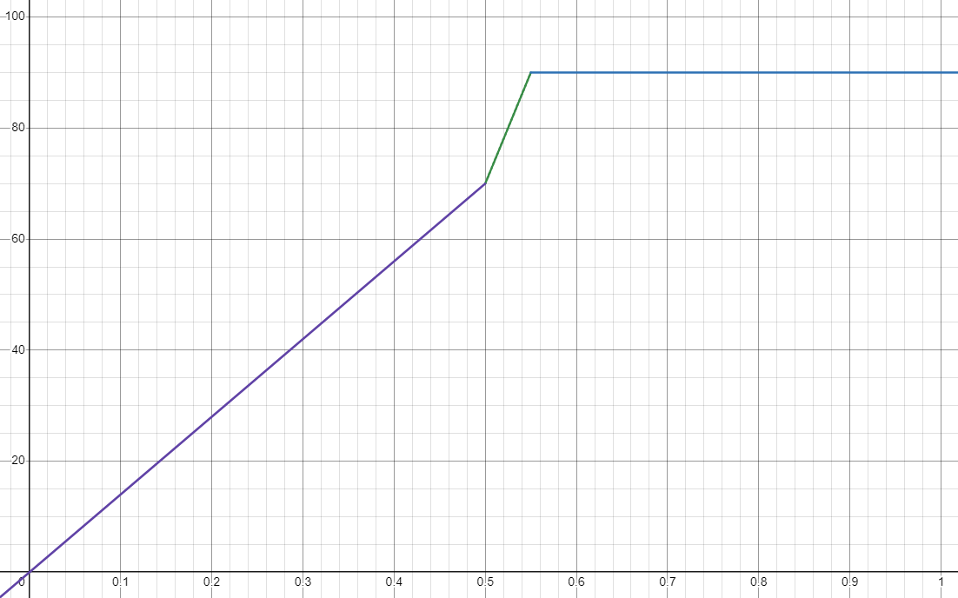
Grading Policy - Kaggle
Assume that:
B_1 = 0.55
B_2 = 0.5
x-axis: F1
y-axis: score

Slide 32
Grading Policy - Kaggle
Ranking (10% of Kaggle)
Compete with your classmates.
Rank 1-5: 10%
Rank 6-10: 8%
...
Rank 21-25: 2%
Rank > 25: no points :(

Slide 33
E3 Submission
Submit your source code and report to E3 before 6/6(Fri.) 23:59, no late submissions will be accepted.
Please submit your source code in python source (.py). For jupyter notebooks, you can use the export function to obtain the executable script. Violation of this rule will cause a deduction of 5 points to your grade.
Do NOT put full code in your report. Only short code snippets and pseudocode (for demonstration purposes) are allowed, and they should be properly formatted.

Slide 34
E3 Submission
Submission format:
hw3_<student_id>.zip
source code: hw3_<student_id>.py or other library files (.py) you made (python files only!)
report: hw3_<student_id>.pdf

Slide 35
Contact
If you have any questions about Final Project, please feel free to contact with TA by email:
Hank Chen (bwchen@cs.nycu.edu.tw)
Kindly format your email so that I can reply it ASAP.
Prefix your email title with [DM]. (e.g. [DM] Questions about Final Project)
Attach your student ID if necessary.

